Slide 1
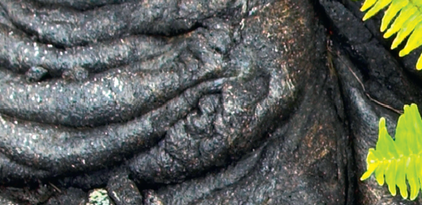
Chapter 6: Changes in ecosystems

Slide 2
Ecosystems can change dramatically over time
110 million years ago none of the continents we know today existed.
They were joined to form a super continent called Pangaea.
Pangaea split into Laurasia (north) and Gondwana (south).
Gondwana split to form the southern land masses, South America, Africa, India, Australia and New Zealand.

Slide 3
Origin of Australia’s unique fauna and flora
Ecosystems can change dramatically over time
Vertebrates were dominated by dinosaurs for 130 million years.
65 million years ago a catastrophic event destroyed most of life on earth.
Dinosaur extinction led to the occupation of the vacant niches by vertebrates.
40 million years ago Australia parted from Antarctica and was isolated.
Isolation and harsh Australian conditions led to development of unique species.
Notes:
Mammals lived with the dinosaurs for almost 130 million years as small and unobtrusive members of the ground fauna. The extinction of the dinosaurs finally opened up new niches previously denied to them. In Australia, at about the same time as the dinosaurs became extinct, the last of the Gondwana land masses were breaking up and by 40 million years ago Australia had parted company with Antarctica, the last remnant of Gondwana. This was an important stage in the physical isolation that was to give Australia’s plants, animals and other organisms such distinctive characteristics.

Slide 4
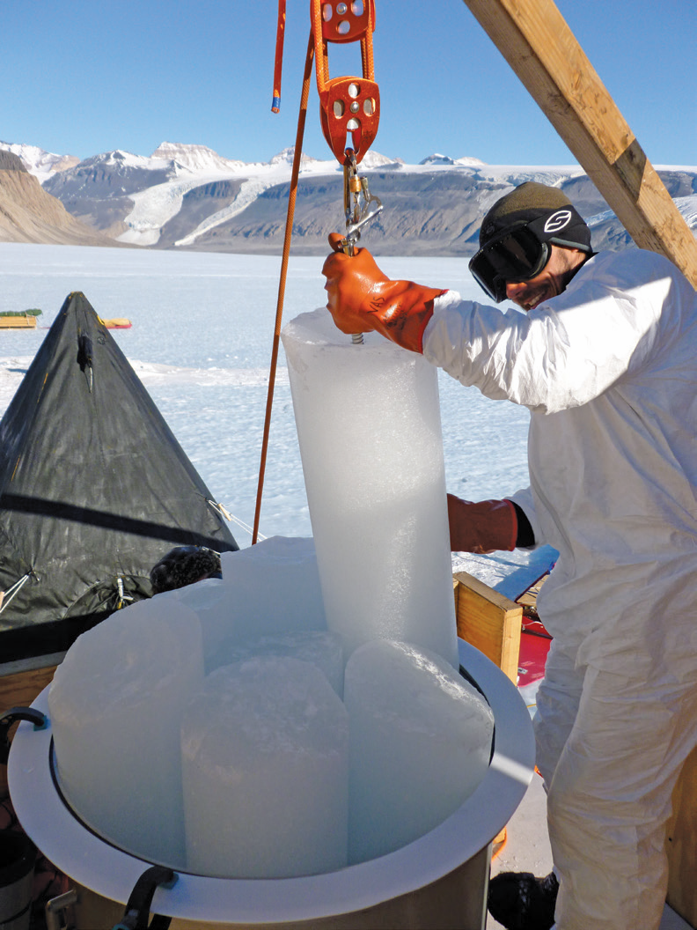
Evidence of changes in past ecosystems
Ecosystems can change dramatically over time
Changes in past ecosystems can be understood by studying regions with abundant fossils
Studies on geological features can help uncover clues to the past environmental conditions
Ice or sediment cores provide an excellent record of changes that have occurred over thousands, perhaps millions, of years
Scientists can analyse changes in trapped gas composition to understand temperature change
Organic matter – abundance of foods.
Figure 6.4 Ice-drilling site, Antarctica.
Notes:
Comparing present biota with those in the fossil record helps us to understand changes in living components of ecosystems over time. Changes in abiotic factors can also be deduced by studying soils, rocks and even ice cores.
Drilling down into the ice at the poles and within large glaciers produces cores that have preserved a continuous record of past climatic conditions: trapped gas bubbles and the presence or absence of traces of organisms reveal information about changes in temperature and relative concentrations of atmospheric gases.

Slide 5
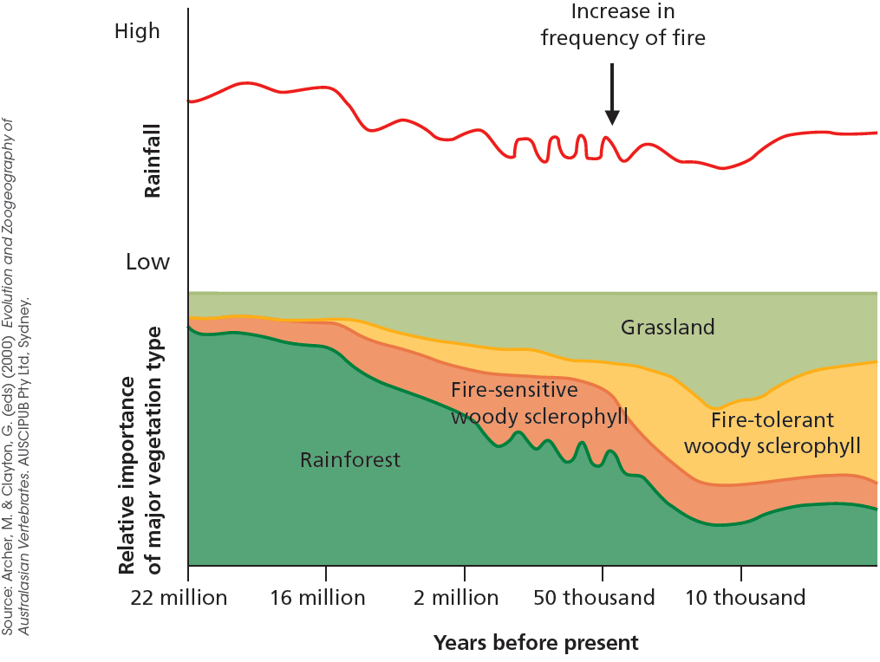
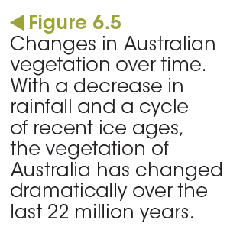
Evidence of changes in past ecosystems
Ecosystems can change dramatically over time

Slide 6
Learning check
Test yourself
Describe the effects of the last ice age on Australia’s climate.
Suggest how the drop in sea level would have helped to preserve biodiversity.

Slide 7
Ecological succession involves changes in the populations of species
Communities change progressively over time, one community being replaced by the next in the process of succession.
Notes:
Communities change progressively over time, one community being replaced by the next in serial replacement known as succession.
Catastrophic events such as volcanic eruptions, cyclones, earthquakes and tsunamis can cause the development of bare sites with no organisms inhabiting the affected area. This process, called nudation, starts a long-term process of change, involving three stages in general.

Slide 8
Ecological succession involves changes in the populations of species
Primary succession
Pioneer plants arrive to colonise the area.
For example:
lichens colonise rocks
mosses inhabit soils
bacteria and fungi form simple communities.
2. These r-selected species are characterised by:
effective seed dispersal
rapid growth
rapid reproduction
producers.
3. Small herbivores move in and new communities form
Notes:
These early colonising plants have characteristics that make them successful: effective seed dispersal, rapid growth, and rapid reproduction. They are generally fast-growing and typical of r-selected species. Temporary environments such as pools formed after heavy rain also attract r-selected species. These species are often the first to occupy the unused resources and living space. Their numbers increase rapidly but often decline just as rapidly when more competitive species move in.

Slide 9
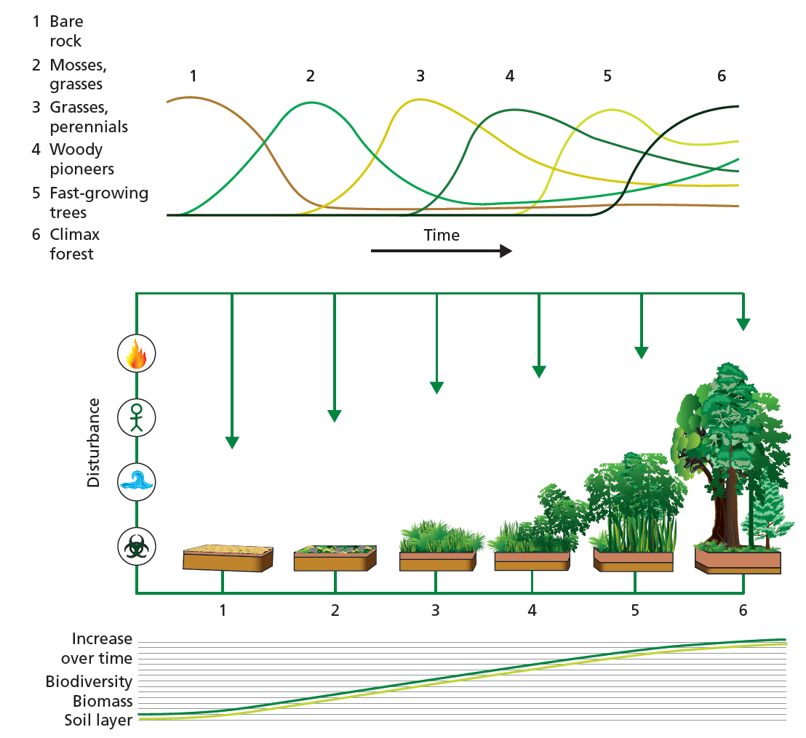
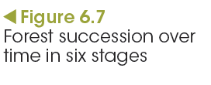
Ecological succession involves changes in the populations of species
Secondary succession
Notes:
Through fire and flood, or human intervention by logging and land clearing for agriculture, dramatic changes to ecosystems occur. The cycling of matter and the flow of energy are interrupted as the components of the ecosystems are affected. Organisms can recolonise recently disturbed communities via secondary succession, regaining equilibrium although the number and kinds of organisms present may be different from the original ecosystem.

Slide 10
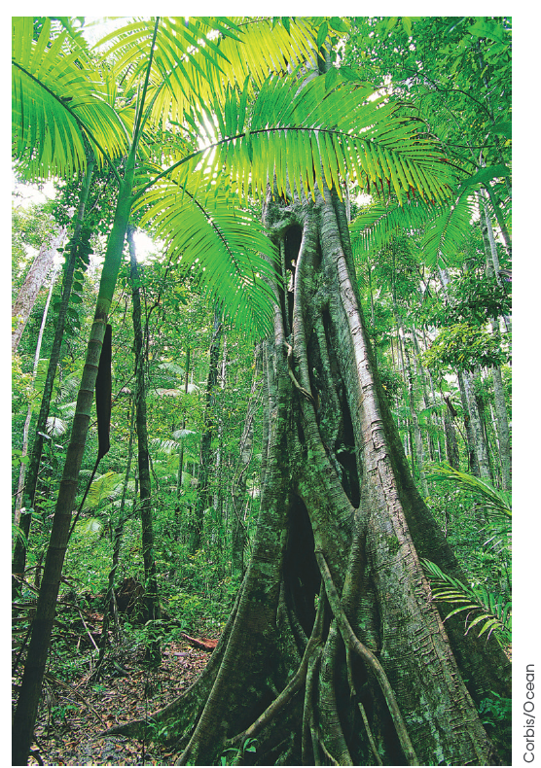
Ecological succession involves changes in the populations of species
Climax community
Slow-growing, long-lived
K-selected species:
live in more stable environments
than r-selected species
outcompete other species
are often tall established trees.
Figure 6.8
The rainforests of south-east Queensland are an example of a climax community.
Notes:
Not all successions reach a climax community. A combination of factors such as fire and selective grazing by herbivores help to create conditions that allows, for example, grasslands to persist.

Slide 11
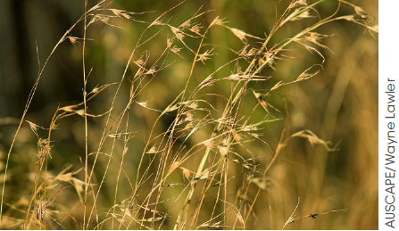
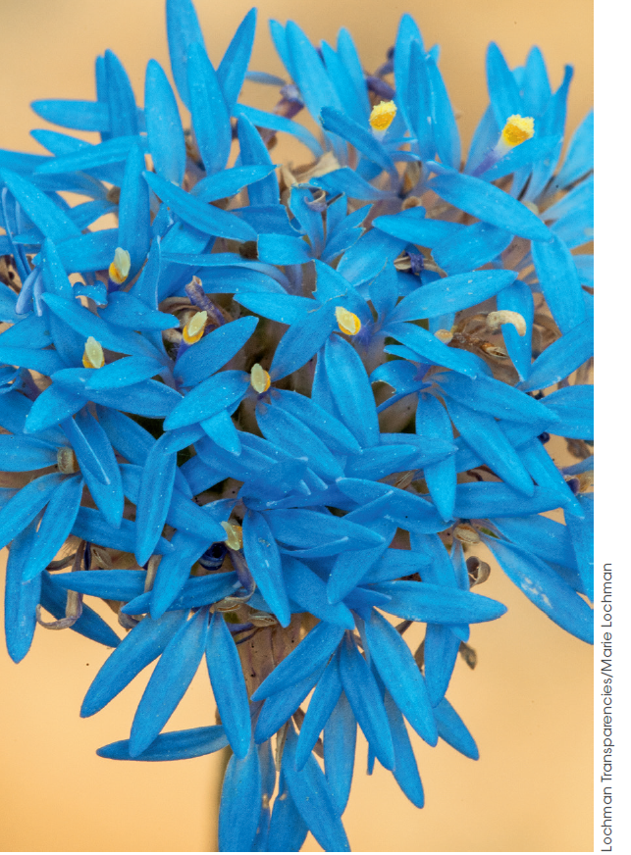
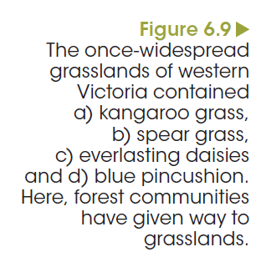
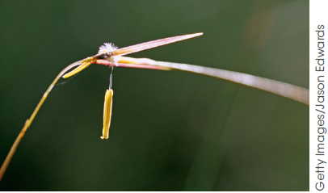
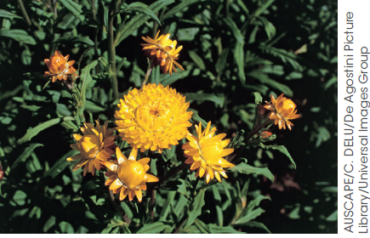
Ecological succession involves changes in the populations of species
Climax community
a
d
b
c
Notes:
Figure 6.9
The once widespread grasslands of western Victoria contained a) kangaroo grass, b) spear grass, c) blue pincushion and d) everlasting daisies. Here forest communities have given way to grasslands. The adaptive success of grasses enabled them to exploit the physical factors that created the deflected, or modified, succession.

Slide 12
Ecological succession involves changes in the populations of species
Natural disturbances can lead to succession
events
A fire or tsunami can cause:
a loss of vegetation
a reduction of leaf litter
a decrease in animal numbers
an impact on abiotic interactions in a community.
Notes:
There are many instances of natural disturbances, such as erupting volcanoes, massive flooding, hurricanes and tornadoes, tsunamis and landslides that change the biotic and abiotic interactions in a community. Depending on the severity, type and extent of the disturbances, primary or secondary succession will follow.
Fire impacts the abiotic interactions in a community. It opens up spaces and creates a nutrient-rich seedbed resulting in secondary succession. The fire causes species such as bottlebrushes, hakeas, some acacias and eucalypts to regenerate from seed. Fire damage stimulates regrowth in other species smoke particles signal growth in others. The proliferation of new growth in a post-fire community attracts many mobile species such as wallabies, birds, small mammals and insects. The new growth sustains animals such as wombats and echidnas that may have survived the fire in underground burrows.

Slide 13
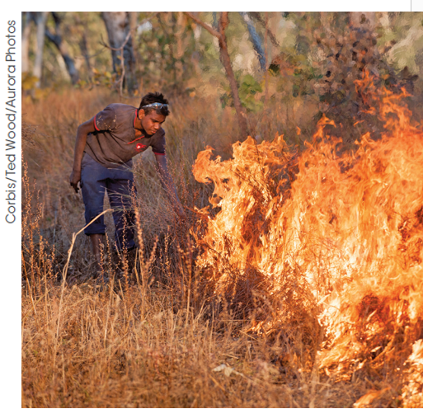
Ecological succession involves changes in the populations of species
Natural disturbances can lead to succession
events
Fire regimes are determined by:
the season
the intensity of fires
how frequently fires occur
Figure 6.12
Fire-stick farming was used by the First Australians to clear areas of
land as an aid for hunting.
Notes:
The controlled fire regimes of these past practices are no longer widespread. In many areas of Australia now, the once fire-tolerant landscapes are being buried alive by a spreading invasion of African grasses such as gamba, para, mission and buffel grasses. Vast areas of woodland in the north and centre of the continent are at risk. These introduced grasses build up huge fuel loads, causing fires of an intensity and timing that native trees, shrubs and grasses cannot withstand.
Eucalypts, acacias and shrubs that make up the unique Australian landscape normally thrive in the natural fires of lower intensity and frequency, but do not survive these. Refuges where Australian native plants and animals survive in intense drought are burnt out, too. If these go, then there is nothing to recolonise the landscape. The Australian woodland will be replaced by grassland, an African grassland.

Slide 14
Test yourself
Learning check
Predict the stages of succession where the majority of species are:
a. r-selected species
b. K-selected species.
Relate the characteristic features of these types of species to the stages of succession.
3. Explain how fire affects succession.

Slide 15
Human activities can reduce biodiversity
Human influence on biodiversity
Humans have inhabited Australia for the past 20 000 years.
Human impacts have included:
species extinction through hunting and loss of habitat
changes to the landscape through farming practices.
Notes:
Australia’s biodiversity is unique and globally significant, but humans have impacted significantly on its natural environment. Australia is recognised as one of only 17 ‘mega-diverse’ countries, with ecosystems of exceptional variety and uniqueness. This group of mega-diverse countries covers less than 10% of the global surface, but supports more than 70% of Earth’s biological diversity. It is this very biodiversity that is attracting attention from those who would exploit it, whether through illegal trading of unusual collector items, searching for natural chemical compounds or attempting to control ownership of native fauna and flora and their products.

Slide 16
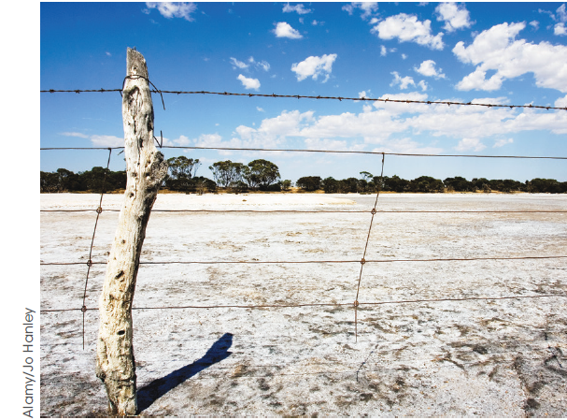
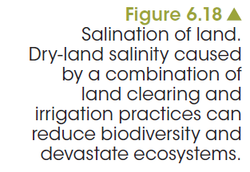
Human activities can reduce biodiversity
Human impact on ecosystems today
Urbanisation
Habitat destruction
Land and soil degradation
Salinity
Monoculture practices
Notes:
As Australia’s population approaches 30 million and continues to grow, there is continued competition for both renewable and non-renewable resources. This parallels the effect of the global increase in population. Competition for land use is considerable: for agriculture; for habitats for native biota; for industrial and domestic constructions; for roads, waste disposal and the spreading urban development; and for minerals, matter and fuels that sustain a consumer society.

Slide 17
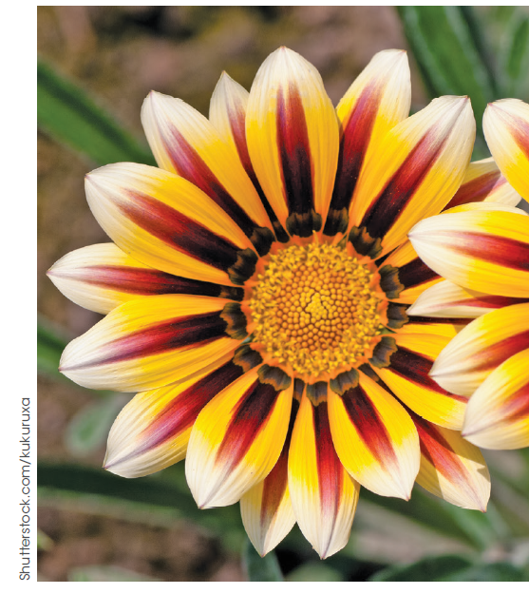
Human activities can reduce biodiversity
Human activities put pressure on resources
Disruption of water flow
Eutrophication
Marine ecosystems
Introduced species can become pests
Figure 6.23
Gazania: one of the 10 most unwanted plants in Australia
Notes:
Distribution of water flow: irrigation, major engineering works, degradation of urban streams and waterways, desnagging and drainage of wetlands.
Eutrophication: the enrichment of water by nutrients, particularly the phosphorous and nitrogen fertilisers, in run-off.
Marine ecosystems: competition for their use for food, recreation, transport, commercial livelihood and as a repository for our wastes.
Introduced species: become serious pests that seriously affect habitats without the normal homeostatic mechanisms for population control, such as natural predators.

Slide 18
Models can be used to predict the impact of change
Human activities can reduce biodiversity
Ecosystem models are useful representations of elements within the ecosystem, the relationship between the elements and the relationship with surrounding ecosystems.
Notes:
Ecosystem models are very useful for simulating and analysing the long-term dynamics and properties of complex ecosystems. They allow the use of information from different disciplines as well as analysing, interpreting and understanding field observations. This provides a basis for predictions of the impacts of changes in real ecosystems, the development of tools for management support and policy advice.

